Slide 1
ANALYSIS
MENU
ANALYSIS
CONTACT
Data ANALYSIS
DATA
SQL

Slide 2
Objective
MENU
ANALYSIS
CONTACT
CAPSTONE
The objective of the project is to use MySQL to analyze the data of the movie rental store for further growth and improved business.

Slide 3
Sakila movie rental store data
MENU
ANALYSIS
CONTACT
CAPSTONE
The Motion Picture Association (MPA) is a movie rating system that rates the suitability of motion pictures for audiences based on its content. The United States and its territories also use MPA to rate motion pictures. The system and the ratings applied to individual motion pictures are the responsibility of MPA.
Sakila is a movie rental store with a vast collection of movies in DVDs and blue ray disc formats. The management wants to analyze the data to understand what kind of movies and actors are often rented. This analysis would help them stock up the inventory of movies to improve their business. This analysis involves a set of tasks to begin with. As an analyst, you are expected to answer the questions put forth by the management

Slide 4
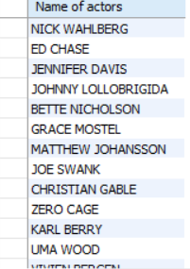
Task 1
MENU
ANALYSIS
CONTACT
Display the full names of all actors.
METHODS concat function is used. | OUTPUT | CONCLUSION From the data, I joined the first name and last name as full name by concatenating it.

Slide 5
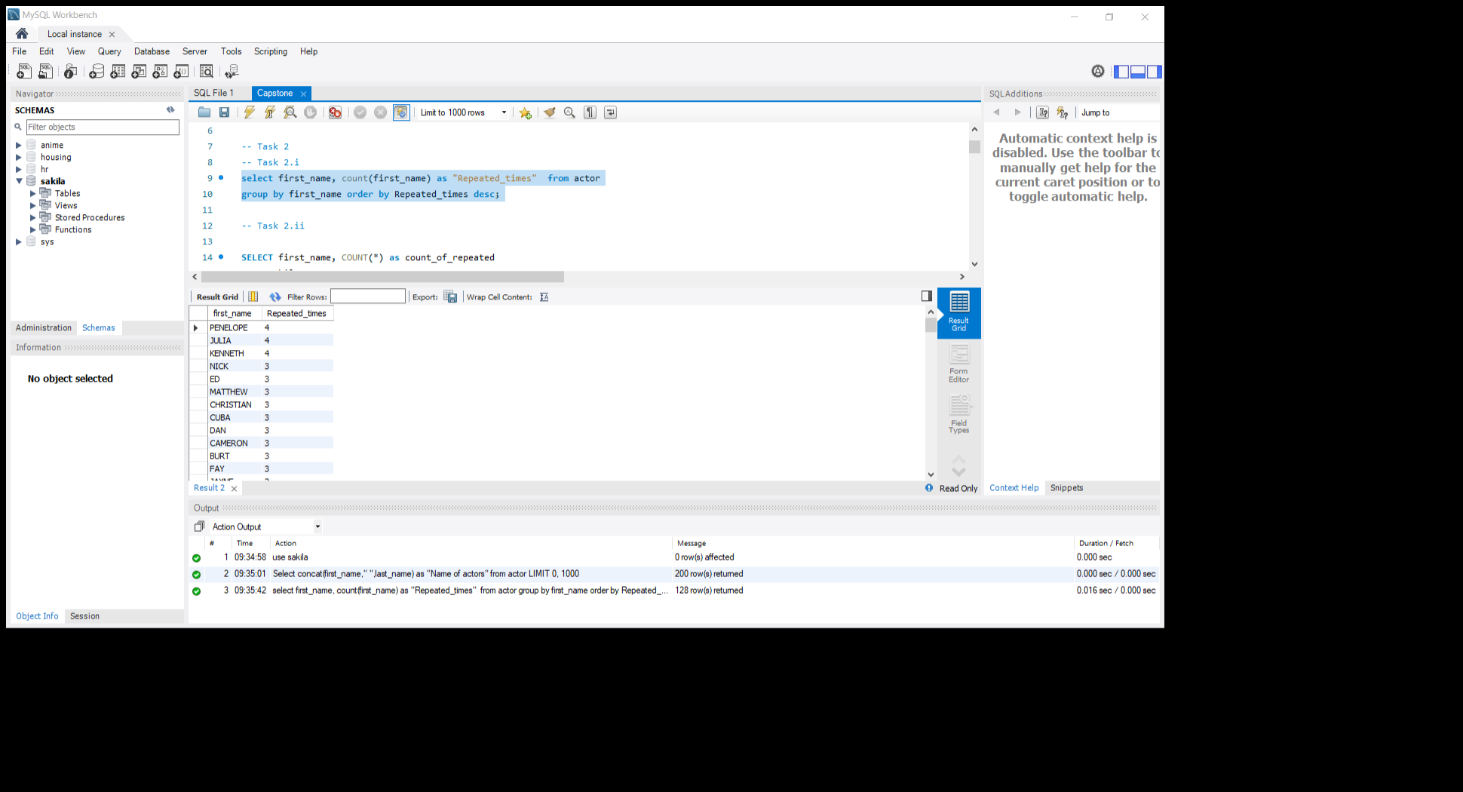
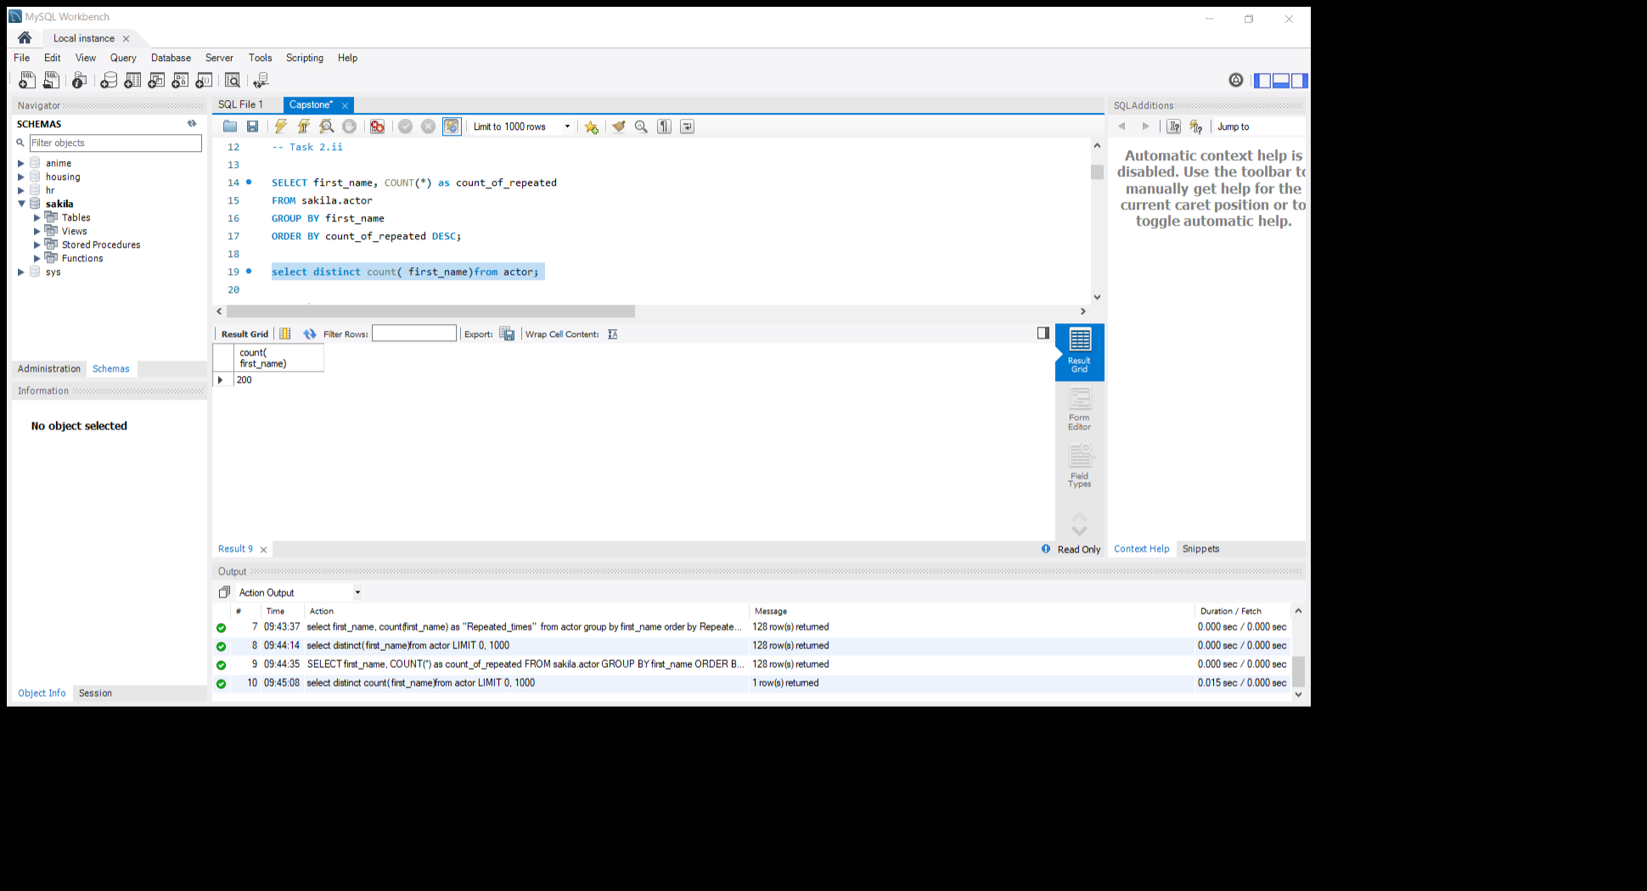
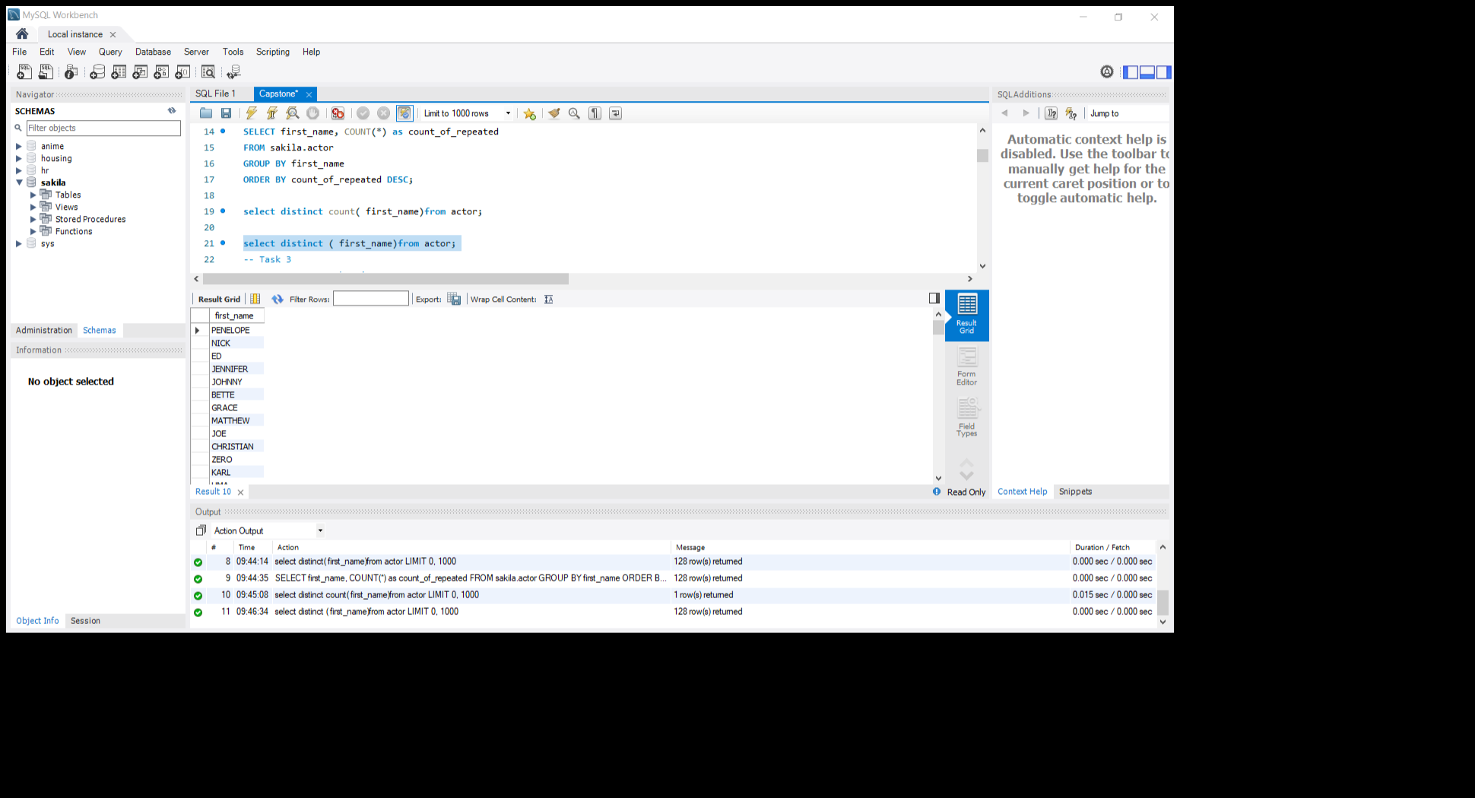
Task 2
MENU
ANALYSIS
CONTACT
Many actors have adopted attractive screen names , mostly at the behest of producers and directors. The management wants to know the following:
Display the first names of actors in database.
what is Count of actors have unique first names . Display the first names of all actors
METHODS a)Select count(*) Grouped by Ordered by DESC is used, b)Used select distinct(first name) Found the count of it | OUTPUT | CONCLUSION From the data, then I found the maximum count of repeated first names and found the unique first name and its count

Slide 6
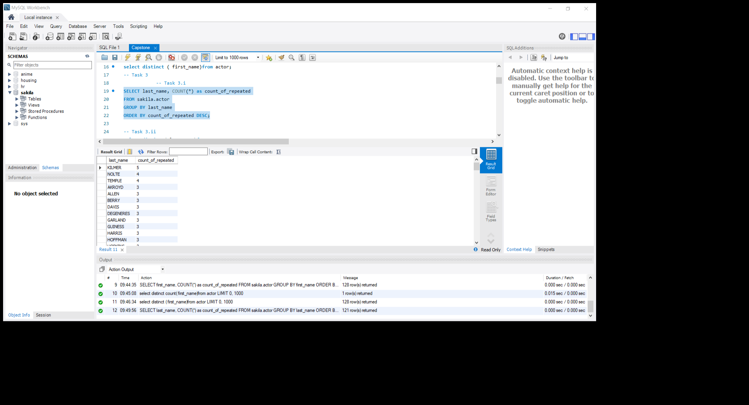
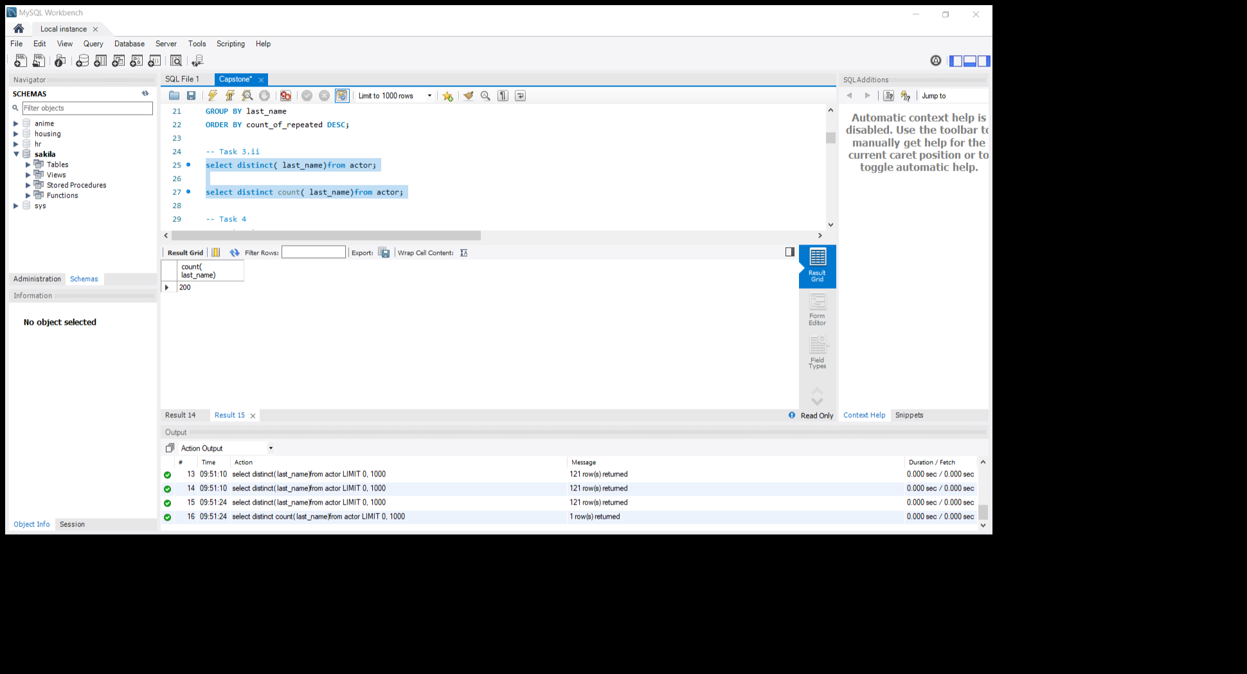
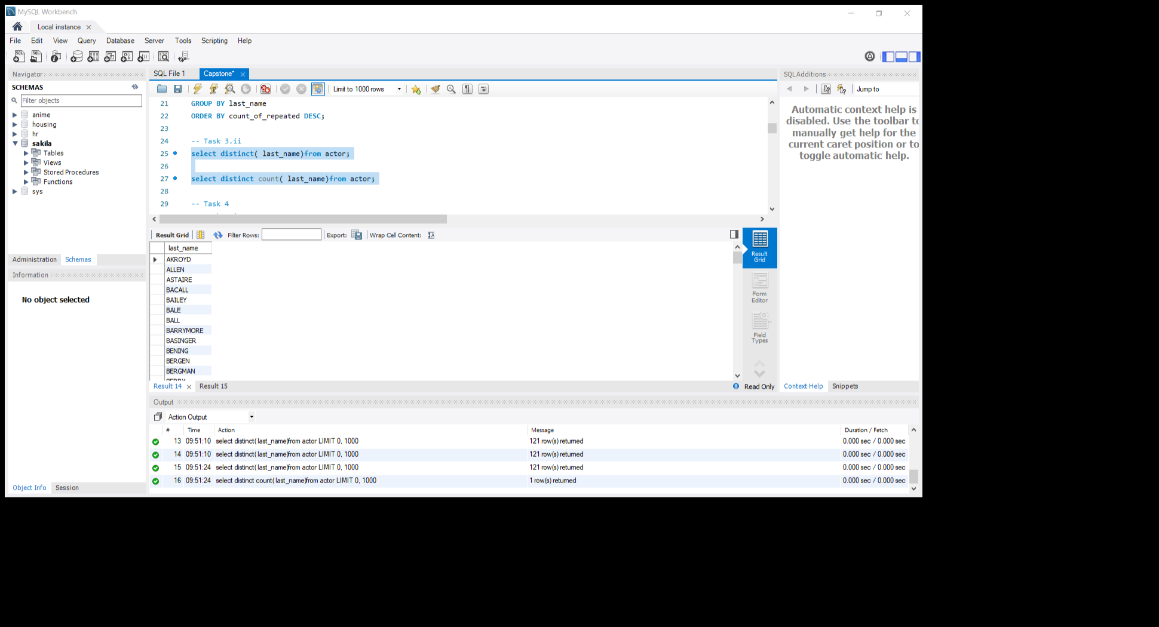
Task 3
MENU
ANALYSIS
CONTACT
The management is interested to analyze the similarity in the last name of actors.
Display the last name of actors along with the count of repeated last names.
Display all unique last names in database
METHODS a)Select count(*) Grouped by Ordered by DESC is used, b)Used select distinct(first name) Found the count of it | OUTPUT | CONCLUSION From the data, then I found the maximum count of repeated last names and found unique last names and its count.

Slide 7
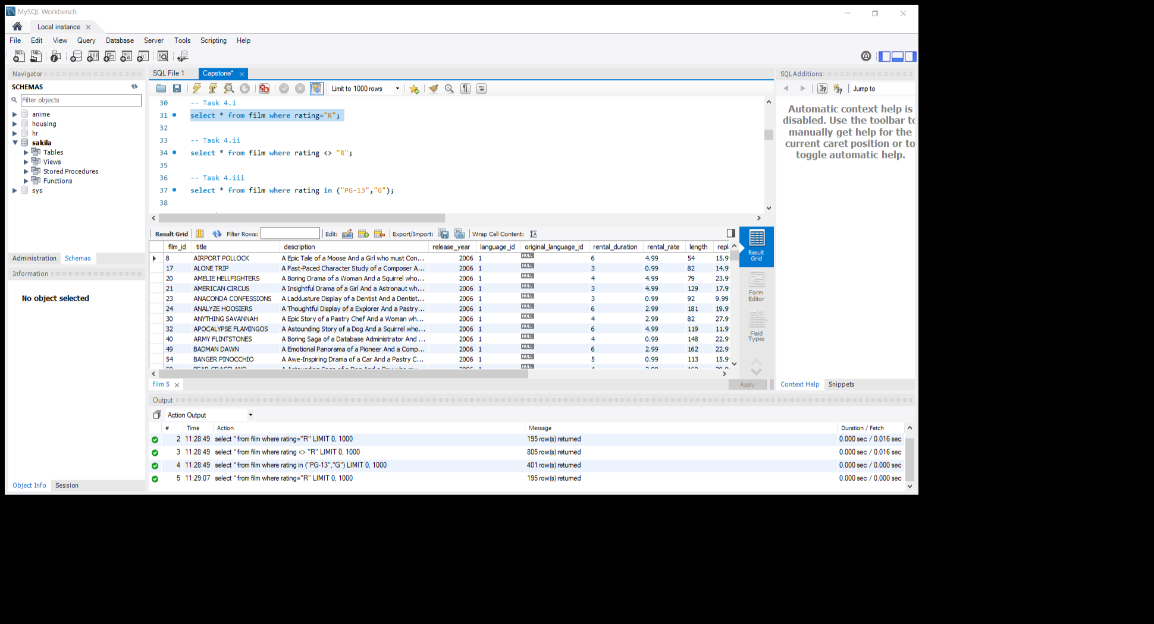
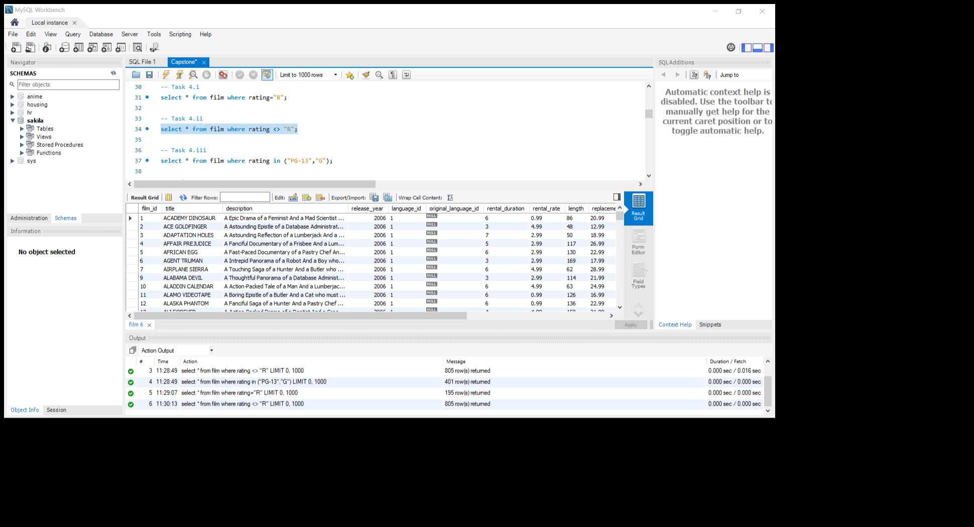
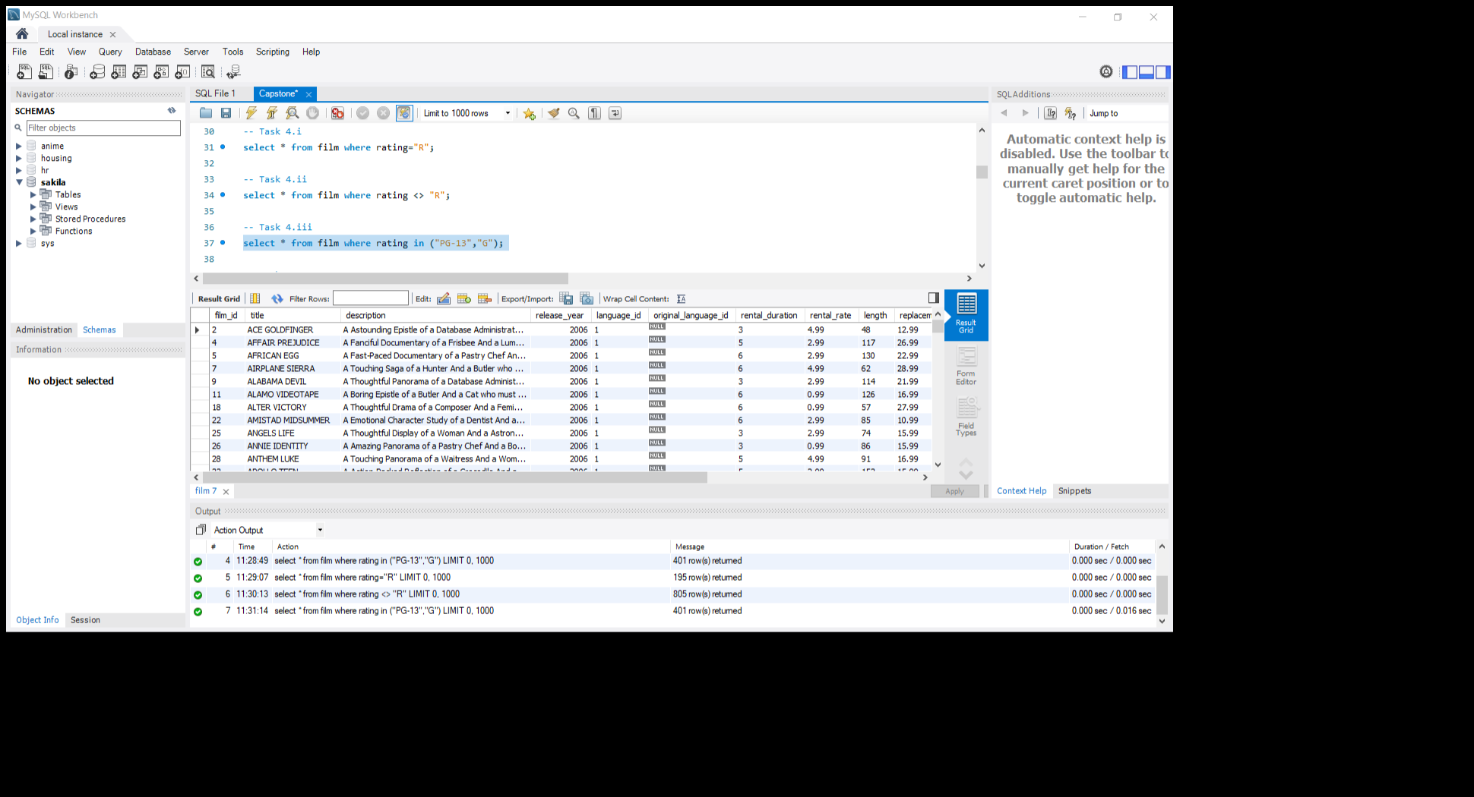
Task 4
MENU
ANALYSIS
CONTACT
The Management Wants to analyze the Movies based on rating
Display the list of records of movies with Rating “R”.
Display the list of records of movies with Rating not “R”.
Display the list of records of movies suitable for audience above 13.
METHODS For all 3 I used Select * to fetch records In where clause I speciefied the conditions for all. | OUTPUT | CONCLUSION From the Data , I fetched the records for movies rated “R” and not rated “R” and I fetched data which movies is suitable for age group below 13 by ratings.

Slide 8
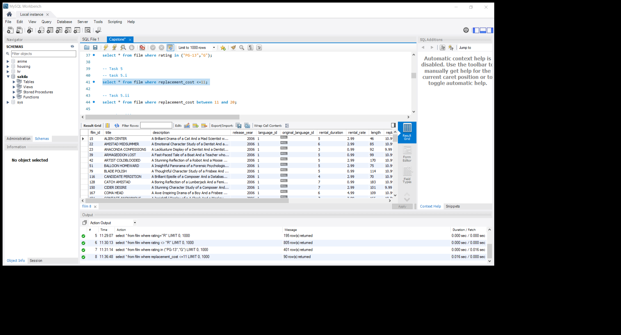
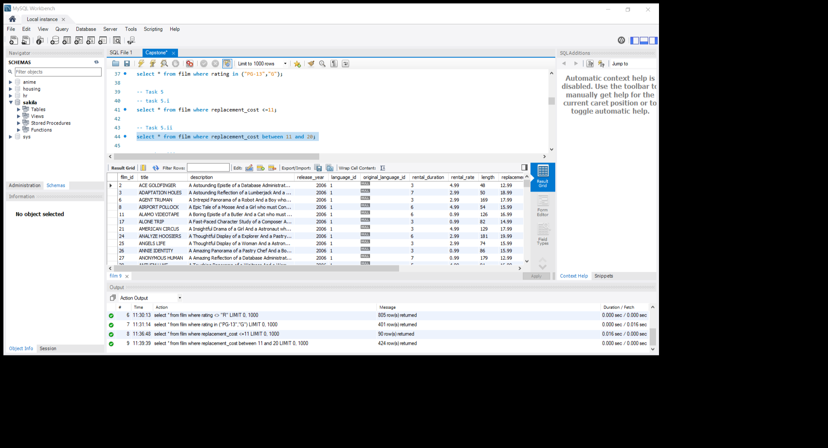
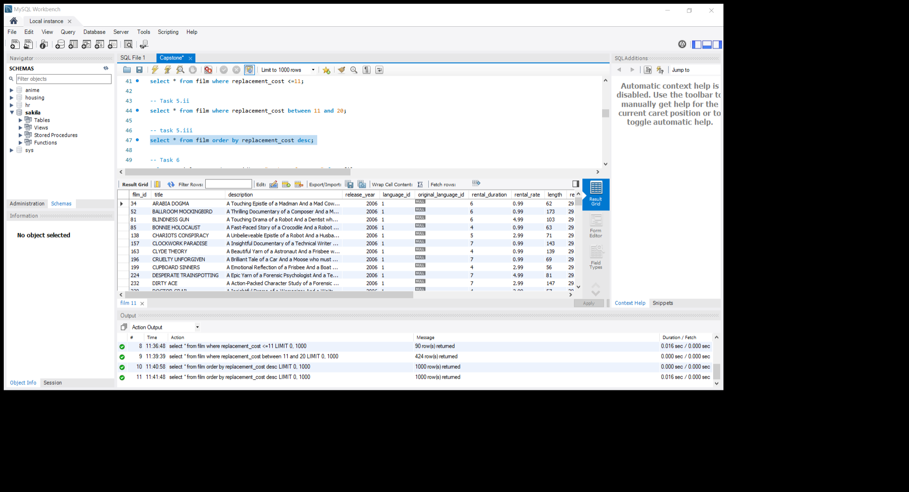
Task 5
MENU
ANALYSIS
CONTACT
The management wants the data about replacement cost of movies. Replacement cost is the amount of money required to replace an existing asset (DVD/blue ray disc) with an equally valued or similar asset at the current market price.
Display the movie titles where the replacement cost is up to $11.
Display the movie titles where replacement cost is between $11 and $20.
Display the list of records of all movies in desc order of replacement costs
METHODS a)select Where b)select Where between c)Select Order by desc | OUTPUT | CONCLUSION From the data the replacement cost<=11 is found that no one is there. The replacement cost between 11 and 20 is found. And found list of records of all movies in desc order of replacement costs

Slide 9
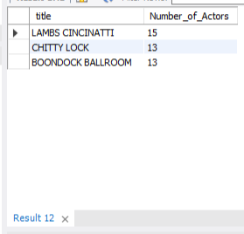
Task 6
MENU
ANALYSIS
CONTACT
Display the top 3 movies with Greatest number of Actors
METHODS SELECT Joined two tables(film and film actor) Group by film id Order by desc | OUTPUT | CONCLUSION From the Data , found top 3 movies with more numbers of actors in it.

Slide 10
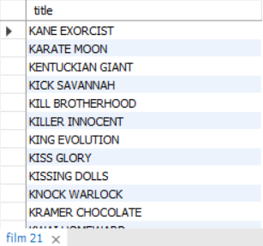
Task 7
MENU
ANALYSIS
CONTACT
The Music of Queen and Kris Kristofferson has seen an unlikely resurgence. As an unintended consequence, movies starting with the letters "K” and "Q" have also soared in popularity. Display the movie titles starting with the letters "K” and "Q”.
METHODS SELECT LIKE | OUTPUT | CONCLUSION From the data the movie titles which stats with letter ‘K’ and ‘Q’ are being found.

Slide 11
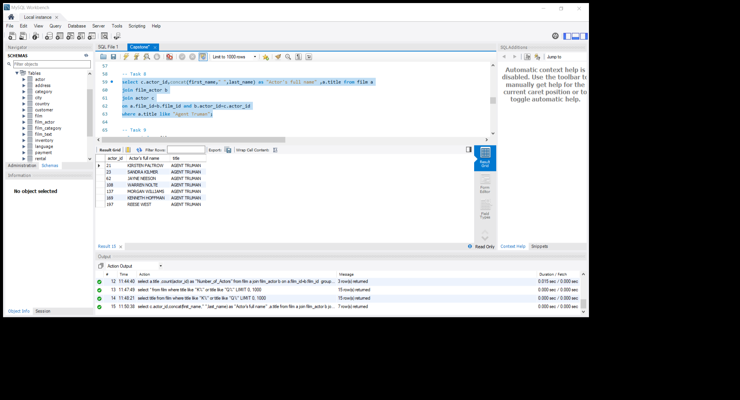
Task 8
MENU
ANALYSIS
CONTACT
The movie ‘AGENT TRUMAN’ has been a great success . Display the first name and last name of all actors who are a part of this movie.
METHODS SELECT Joined using actor_id Joined using film id Where | OUTPUT | CONCLUSION From the data the first name and last name as Actor’s fullname of the actors who acted on the movie ‘AGENT TRUMAN’ is listed.

Slide 12
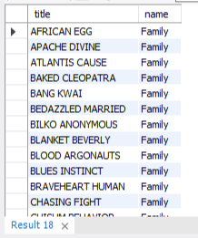
Task 9
MENU
ANALYSIS
CONTACT
Sales has been down among the family audience with kids . The management wants to promote the movies that falls under the ‘children’ category. Identify and display the names of the movies in the family category.
METHODS SELECT Joined using film_id Joined using category id WHERE | OUTPUT | CONCLUSION From the data the movie titles in the family category is being listed.

Slide 13
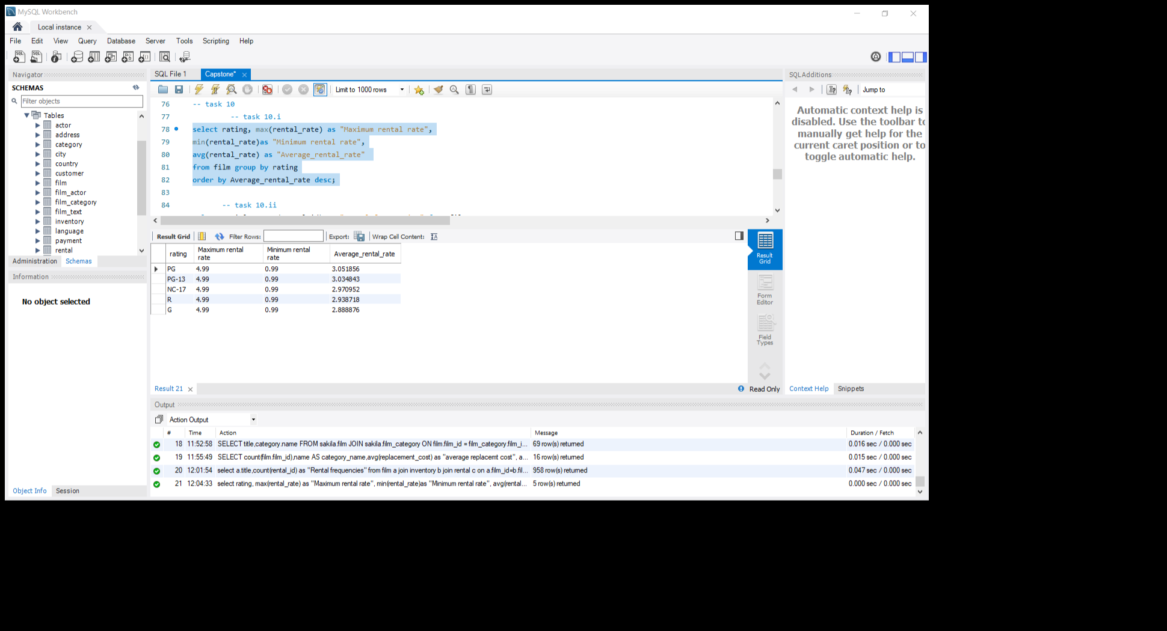

Task 10
MENU
ANALYSIS
CONTACT
Display the average , maximum and minimum rental rates of movies based on rating.sorted in desc order of avg rental rates
Display the movies in desc order of rental frequencies
METHODS a)SELECT. Min, max and avg(rental rate) Group by Order by desc b)SELECT Joined on film Id Joined on inventory id Group Order in descending. | OUTPUT | CONCLUSION From the data , found min,max and avg rental rates and ordered it and the names of the most frequently rented movies are listed in descending order.

Slide 14
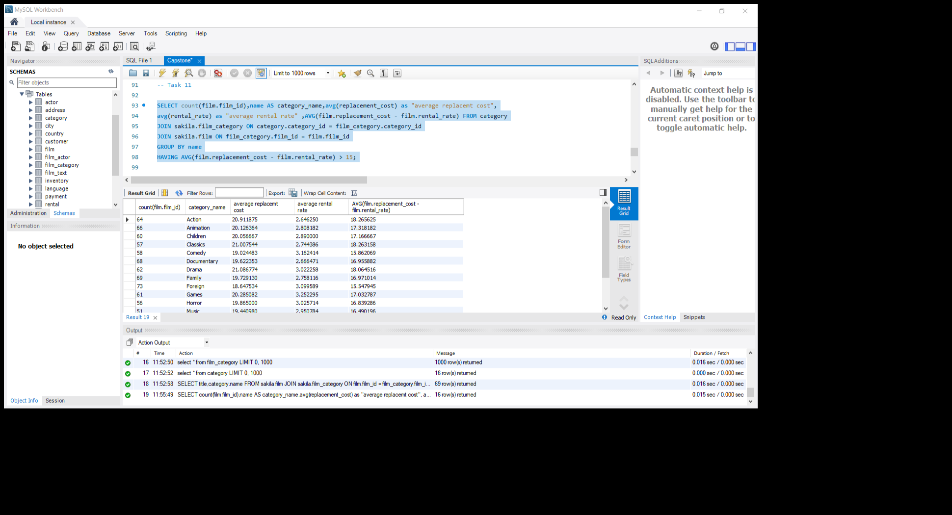
Task 11
MENU
ANALYSIS
CONTACT
Calculate and display the number of movie categories where the average difference between the movie replacement cost and the rental rate is greater than $15.
METHODS SELECT count(film.film_id),name, Joined on category id Join Group HAVING AVG | OUTPUT | CONCLUSION From the data the number of movie categories where average difference between replacement cost and rental rate greater than 15 is listed.

Slide 15
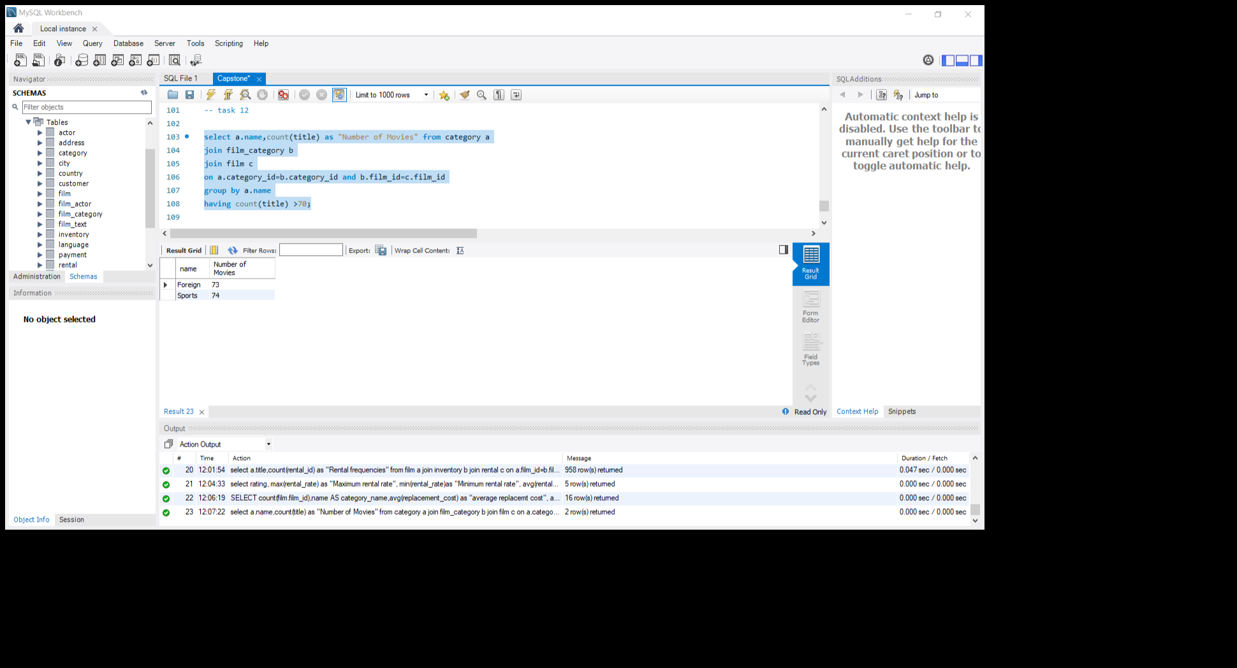
Task 12
MENU
ANALYSIS
CONTACT
Display the film categories in which the number of movies is greater than 70
METHODS SELECT Joined using category id and film id Group HAVING Ordered by descending. | OUTPUT | CONCLUSION From the data the number of movie according to category is listed in the range above 70

Slide 16
MENU
ANALYSIS
CONTACT
Thank you

